Slide 1
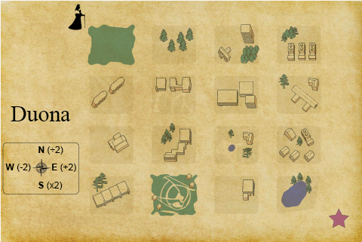
The Pilgrim’s Puzzle
A pilgrim arrives in Duona, a sixteen-block town created by five streets running north-south that intersect with five streets running east-west.
Like all pilgrims, she arrives in the northwest corner of town, and needs to make her way to a shrine in the southeast corner.
Unfortunately for the pilgrim, Duona imposes a tax system on visitors, charging 2 silver pieces for each block walked to the east, and doubling what you owe every time you walk south.
To make the payment system fairer and encourage longer stays, they subtract 2 silver pieces for each block walked to the west, and halve what you owe when you walk a block north.
The townsfolk keep track of your path, and you must pay in full on your arrival in the southeast corner.
(Legend has it that certain savvy travelers have planned trips through the town and ended up receiving silver by following the tax rules.)
The pilgrim has no money, and has no intention of leaving with any.
How can she travel to the southeast corner of Duona without owing or receiving any silver?
https://wordplay.blogs.nytimes.com/2013/08/26/pilgrim/

Slide 2
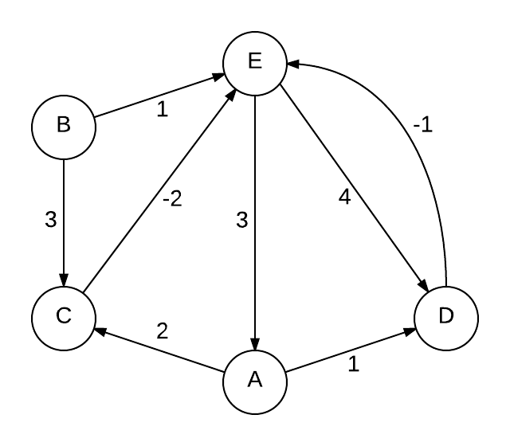
α
-5
θ
γ
λ
β
ε
ζ
δ
Priority Queue (distTo, target, edge)
 | Seen | PathFrom | DistTo
A |  | None | Inf
B |  | None | 0
C |  | None | Inf
D |  | None | Inf
E |  | None | Inf

Slide 3
α
-5
θ
γ
λ
β
ε
ζ
δ
Priority Queue (distTo, target, edge)
1,E, α
3,C, β
 | Seen | PathFrom | DistTo
A |  | None | Inf
B |  | None | 0
C |  | None | Inf
D |  | None | Inf
E |  | None | Inf

Slide 4
α
-5
θ
γ
λ
β
ε
ζ
δ
Priority Queue (distTo, target, edge)
3,C, β
 | Seen | PathFrom | DistTo
A |  | None | Inf
B | True | None | 0
C |  | None | Inf
D |  | None | Inf
E |  | α | 1

Slide 5
α
-5
θ
γ
λ
β
ε
ζ
δ
Priority Queue (distTo, target, edge)
3,C, β
4,A, ε
5,D, λ
 | Seen | PathFrom | DistTo
A |  | None | Inf
B | True | None | 0
C |  | None | Inf
D |  | None | Inf
E | True | α | 1

Slide 6
α
-5
θ
γ
λ
β
ε
ζ
δ
Priority Queue (distTo, target, edge)
4,A, ε
5,D, λ
 | Seen | PathFrom | DistTo
A |  | None | Inf
B | True | None | 0
C |  | β | 3
D |  | None | Inf
E | True | α | 1

Slide 7
α
-5
θ
γ
λ
β
ε
ζ
δ
Priority Queue (distTo, target, edge)
1,E, γ
4,A, ε
5,D, λ
 | Seen | PathFrom | DistTo
A |  | None | Inf
B | True | None | 0
C | True | β | 3
D |  | None | Inf
E | True | α | 1

Slide 8
α
-5
θ
γ
λ
β
ε
ζ
δ
Priority Queue (distTo, target, edge)
4,A, ε
5,D, λ
 | Seen | PathFrom | DistTo
A |  | None | Inf
B | True | None | 0
C | True | β | 3
D |  | None | Inf
E | True | α | 1

Slide 9
α
-5
θ
γ
λ
β
ε
ζ
δ
Priority Queue (distTo, target, edge)
5,D, λ
 | Seen | PathFrom | DistTo
A |  | ε | 4
B | True | None | 0
C | True | β | 3
D |  | None | Inf
E | True | α | 1

Slide 10
α
-5
θ
γ
λ
β
ε
ζ
δ
Priority Queue (distTo, target, edge)
5,D, λ
5,D, ζ
6,C, δ
 | Seen | PathFrom | DistTo
A | True | ε | 4
B | True | None | 0
C | True | β | 3
D |  | None | Inf
E | True | α | 1

Slide 11
α
-5
θ
γ
λ
β
ε
ζ
δ
Priority Queue (distTo, target, edge)
5,D, ζ
6,C, δ
 | Seen | PathFrom | DistTo
A | True | ε | 4
B | True | None | 0
C | True | β | 3
D |  | λ | 5
E | True | α | 1

Slide 12
α
-5
θ
γ
λ
β
ε
ζ
δ
Priority Queue (distTo, target, edge)
0,E, θ
5,D, ζ
6,C, δ
 | Seen | PathFrom | DistTo
A | True | ε | 4
B | True | None | 0
C | True | β | 3
D | True | λ | 5
E | True | α | 1

Slide 13
α
-5
θ
γ
λ
β
ε
ζ
δ
Priority Queue (distTo, target, edge)
5,D, ζ
6,C, δ
 | Seen | PathFrom | DistTo
A | True | ε | 4
B | True | None | 0
C | True | β | 3
D | True | λ | 5
E | True | θ | 0

Slide 14
α
-5
θ
γ
λ
β
ε
ζ
δ
Priority Queue (distTo, target, edge)
6,C, δ
 | Seen | PathFrom | DistTo
A | True | ε | 4
B | True | None | 0
C | True | β | 3
D | True | λ | 5
E | True | θ | 0

Slide 15
α
-5
θ
γ
λ
β
ε
ζ
δ
Priority Queue (distTo, target, edge)
 | Seen | PathFrom | DistTo
A | True | ε | 4
B | True | None | 0
C | True | β | 3
D | True | λ | 5
E | True | θ | 0

Slide 16
α
-5
θ
γ
λ
β
ε
ζ
What’s wrong??
δ
Priority Queue (distTo, target, edge)
 | Seen | PathFrom | DistTo
A | True | ε | 4
B | True | None | 0
C | True | β | 3
D | True | λ | 5
E | True | θ | 0

Slide 17

As you can see, Dijkstra’s Algorithm doesn’t always work for graphs that have negative weightings…
...we need something new.

Slide 18
Pseudocode
For each node except the start node
Initialise the distance of the node to infinity
Set the distance to the start node to 0
Let n be the number of nodes
Repeat the following process n-1 times or until all of the distance values stop changing
Look at each edge in turn and add the distance to the start node to the edge
Length, if this distance is less than the current distance of the end node,
update this distance, otherwise, leave it the same.
return d(B)

Slide 19
Pseudocode
For each node except the start node
Initialise the distance of the node to infinity
Set the distance to the start node to 0
Let n be the number of nodes
Repeat the following process n-1 times or until all of the distance values stop changing
Look at each edge in turn and add the distance to the start node to the edge
Length, if this distance is less than the current distance of the end node,
update this distance, otherwise, leave it the same.
return d(B)
This is called relaxing an edge.

Slide 20
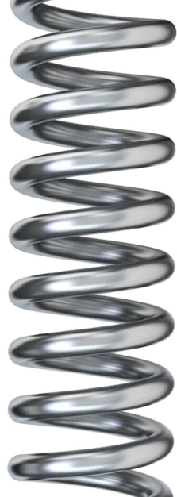
Pseudocode
For each node except the start node
Initialise the distance of the node to infinity
Set the distance to the start node to 0
Let n be the number of nodes
Repeat the following process n-1 times or until all of the distance values stop changing
Look at each edge in turn and add the distance to the start node to the edge
Length, if this distance is less than the current distance of the end node,
update this distance, otherwise, leave it the same.
return d(B)
This is called relaxing an edge.

Slide 21
Pseudocode
For each node except the start node
Initialise the distance of the node to infinity
Set the distance to the start node to 0
Let n be the number of nodes
Repeat the following process n-1 times or until all of the distance values stop changing
Look at each edge in turn and add the distance to the start node to the edge
Length, if this distance is less than the current distance of the end node,
update this distance, otherwise, leave it the same.
return d(B)
This is called relaxing an edge.

Slide 22
Bellman Ford Algorithm
input: an edge weighted directed graph G; two nodes A, B;
output: the shortest path distance from A to B
assumption: B is reachable from A
foreach i from 1 to number of nodes node x in G
initialize distance estimate d(x) to infinity
initialize d(A) to 0
for i from 1 to length(allNodes(G))-1
foreach edge e in allEdges(G)
d(endNode(e)) := min(d(endNode(e)), d(startNode(e)+w(e)))
end
end
return d(B)

Slide 23
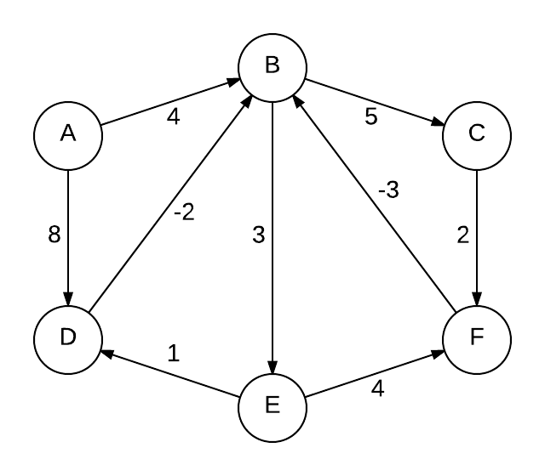
Bellman-Ford Algorithm
 |  | 1st | 2nd | 3rd | 4th | 5th
A | ∞
B | ∞
C | ∞
D | ∞
E | ∞
F | 0
E
C

Slide 24
Bellman-Ford Algorithm
Using these order of edges:
a->b, d->a, d->b, b->c, c->d, b->e, e->f, f->b, c->f
 |  | 1st | 2nd | 3rd | 4th | 5th
A | ∞
B | ∞
C | ∞
D | ∞
E | ∞
F | 0
E
C

Slide 25
Bellman-Ford Algorithm
Using these order of edges:
a->b, d->a, d->b, b->c, c->d, b->e, e->f, f->b, c->f
 |  | 1st | 2nd | 3rd | 4th | 5th
A | ∞ | ∞ | ∞ | 9 | 9
B | ∞ | -3 | -3 | -3 | -3
C | ∞ | ∞ | 0 | 0 | 0
D | ∞ | ∞ | 1 | 1 | 1
E | ∞ | ∞ | 2 | 2 | 2
F | 0 | 0 | 0 | 0 | 0
E
C

Slide 26
Bellman-Ford Algorithm
Using these order of edges:
a->b, d->a, d->b, b->c, c->d, b->e, e->f, f->b, c->f
 |  | 1st | 2nd | 3rd | 4th | 5th
A | ∞ | ∞ | ∞ | 9 | 9
B | ∞ | -3 | -3 | -3 | -3
C | ∞ | ∞ | 0 | 0 | 0
D | ∞ | ∞ | 1 | 1 | 1
E | ∞ | ∞ | 2 | 2 | 2
F | 0 | 0 | 0 | 0 | 0
E
C

Slide 27
Bellman-Ford Algorithm
 |  | 1st | 2nd | 3rd | 4th | 5th
A | ∞
B | ∞
C | ∞
D | ∞
E | ∞
F | 0
E
E
-5
C
C

Slide 28
Bellman-Ford Algorithm
Using these order of edges:
a->b, d->a, d->b, b->c, c->d, b->e, e->f, f->b, c->f
 |  | 1st | 2nd | 3rd | 4th | 5th
A | ∞ |  |  | 9 | 8 | 7
B | ∞ | -3 | -3 | -4 | -5 | -6
C | ∞ |  | 0 | -1 | -2 | -3
D | ∞ |  | 1 | 0 | -1 | -2
E | ∞ |  | 2 | 1 | 0 | -1
F | 0 | 0 | 0 | 0 | 0 | -1
E
E
-5
C
C

Slide 29
Bellman-Ford Algorithm
Using these order of edges:
a->b, d->a, d->b, b->c, c->d, b->e, e->f, f->b, c->f
 |  | 1st | 2nd | 3rd | 4th | 5th
A | ∞ | ∞ | ∞ | 9 | 8 | 7
B | ∞ | -3 | -3 | -4 | -5 | -6
C | ∞ | ∞ | 0 | -1 | -2 | -3
D | ∞ | ∞ | 1 | 0 | -1 | -2
E | ∞ | ∞ | 2 | 1 | 0 | -1
F | 0 | 0 | 0 | 0 | 0 | -1
E
E
E
-5
C
C

Slide 30
Bellman-Ford Algorithm
Using these order of edges:
a->b, d->a, d->b, b->c, c->d, b->e, e->f, f->b, c->f
 |  | 1st | 2nd | 3rd | 4th | 5th | 6th
A | ∞ | ∞ | ∞ | 9 | 8 | 7 | 6
B | ∞ | -3 | -3 | -4 | -5 | -6 | -7
C | ∞ | ∞ | 0 | -1 | -2 | -3 | -4
D | ∞ | ∞ | 1 | 0 | -1 | -2 | -3
E | ∞ | ∞ | 2 | 1 | 0 | -1 | -2
F | 0 | 0 | 0 | 0 | 0 | -1 | -2
E
E
-5
C
C

Slide 31
Bellman-Ford Algorithm
Using these order of edges:
a->b, d->a, d->b, b->c, c->d, b->e, e->f, f->b, c->f
 |  | 1st | 2nd | 3rd | 4th | 5th | 6th
A | ∞ | ∞ | ∞ | 9 | 8 | 7 | 6
B | ∞ | -3 | -3 | -4 | -5 | -6 | -7
C | ∞ | ∞ | 0 | -1 | -2 | -3 | -4
D | ∞ | ∞ | 1 | 0 | -1 | -2 | -3
E | ∞ | ∞ | 2 | 1 | 0 | -1 | -2
F | 0 | 0 | 0 | 0 | 0 | -1 | -2
E
E
-5
C
C

Slide 32
Bellman-Ford Algorithm
Using these order of edges:
a->b, d->a, d->b, b->c, c->d, b->e, e->f, f->b, c->f
 |  | 1st | 2nd | 3rd | 4th | 5th | 6th
A | ∞ | ∞ | ∞ | 9 | 8 | 7 | 6
B | ∞ | -3 | -3 | -4 | -5 | -6 | -7
C | ∞ | ∞ | 0 | -1 | -2 | -3 | -4
D | ∞ | ∞ | 1 | 0 | -1 | -2 | -3
E | ∞ | ∞ | 2 | 1 | 0 | -1 | -2
F | 0 | 0 | 0 | 0 | 0 | -1 | -2
E
E
-5
C
C
Any further relaxation in the n^{th} iteration indicates the presence of a cycle!

Slide 33
Have a go yourself
Using these order of edges:
a->c, a->d, c->e, e->d, b->c, b->e, d->e, e->a
 |  | 1st | 2nd | 3rd | 4th | 5th
A | ∞
B | 0
C | ∞
D | ∞
E | ∞
-5

Slide 34
Have a go yourself
Using these order of edges:
a->c, a->d, c->e, e->d, b->c, b->e, d->e, e->a
 |  | 1st | 2nd | 3rd | 4th | 5th
A | ∞ | 4 | 3 | 2 | 1 | 0
B | 0 | 0 | 0 | 0 | 0 | 0
C | ∞ | 3 | 3 | 3 | 3 | 3
D | ∞ | ∞ | 5 | 4 | 3 | 2
E | ∞ | 1 | 0 | -1 | -2 | -3
-5

Slide 35
Have a go yourself
Using these order of edges:
a->c, a->d, c->e, e->d, b->c, b->e, d->e, e->a
 |  | 1st | 2nd | 3rd | 4th | 5th
A | ∞ | 4 | 3 | 2 | 1 | 0
B | 0 | 0 | 0 | 0 | 0 | 0
C | ∞ | 3 | 3 | 3 | 3 | 3
D | ∞ | ∞ | 5 | 4 | 3 | 2
E | ∞ | 1 | 0 | -1 | -2 | -3
-5

